Slide 1


Service Excellence using Evaluetor©
Johan van Campen
Eindhoven, September 3rd 2014

Slide 2
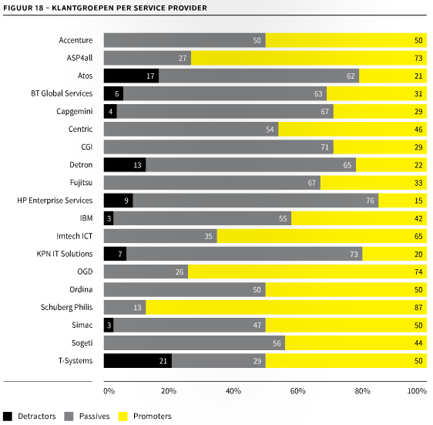
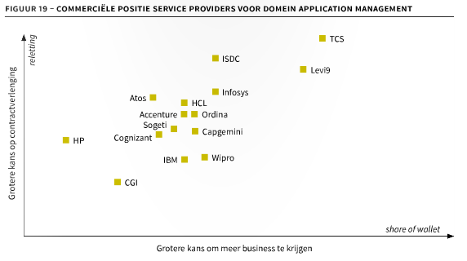
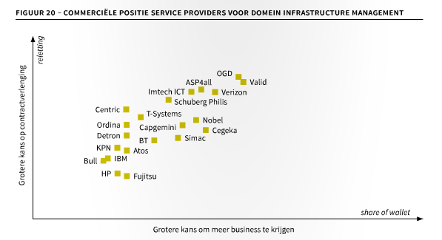
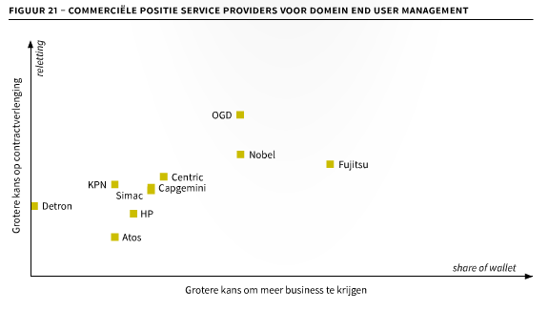
Call for Action
Source: Giarte outsourcing performance 2014

Slide 3
Added value of Evaluetor Service Excellence
Companies that have implemented Evaluetor Service Excellence have:
Case-1 : only 18 months after initiation of our program:
Increased the Outsourcing Recommendation Index with 14 points;
Increased the number of Promoters of our client with 21%;
As a result we have de-risked 11% of their revenue;
And recorded a 6% growth of add-on business within the existing customer portfolio.
Case-2 : results after 3 year:
Customer retention increased from 53% to 82%;
Increase of referenceability with 20%;
Increase win rate with 10%;
Decrease of operational cost of 5%.
Proven experience
with similar
service companies

Slide 4
Why does it work?
Inside-out Thinking
Real-time Customer Satisfaction
Active Improvement Management
Integrated Governance
Internal Perception Recording
Service Excellence Compliance
One TRUTH
Active Contract Management

Slide 5
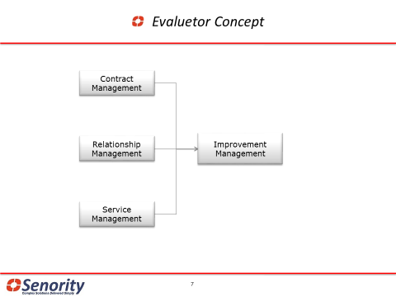
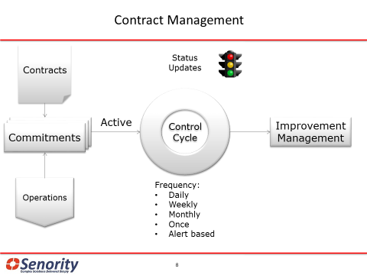
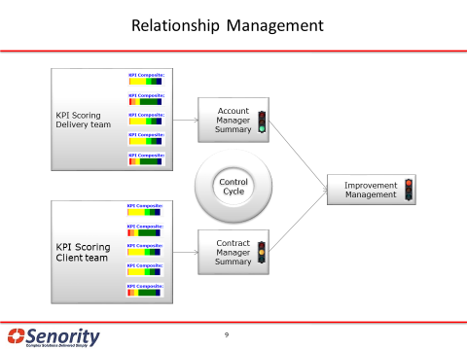
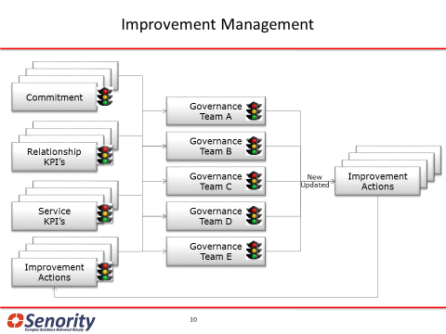
How does Evaluetor work?

Slide 6
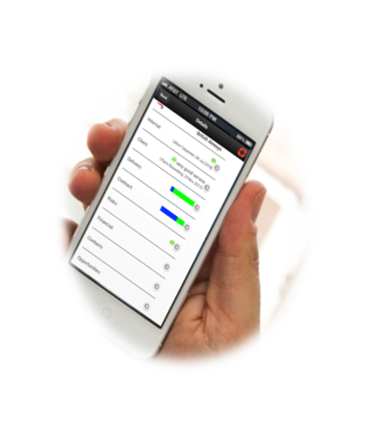
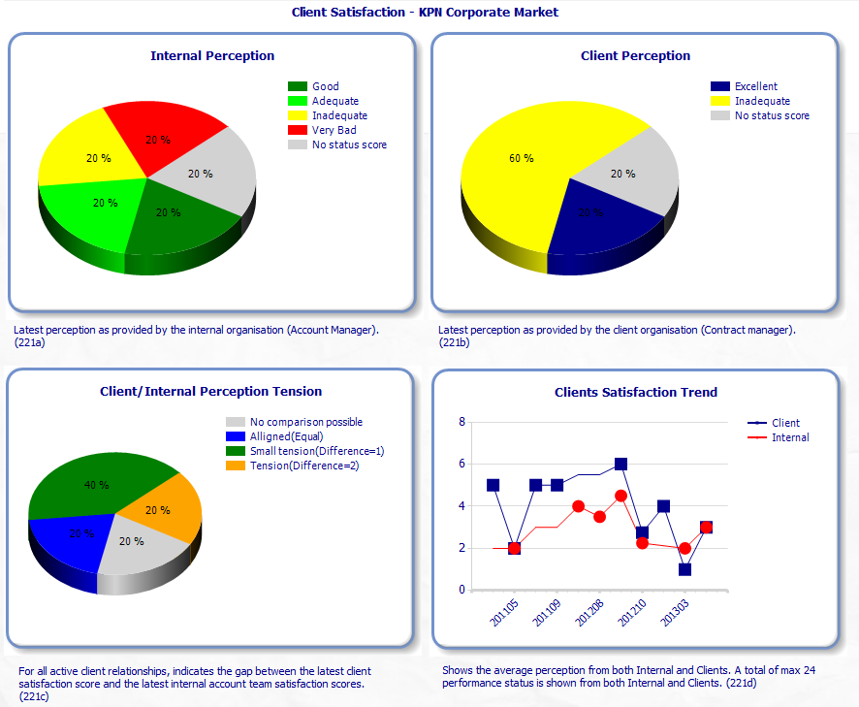
Evaluetor Executive Monitor
Making Business Relationships
“Transparent, Measurable and Actionable”

Slide 7
Recommended Course Of Action
2 pilot Accounts than Evaluate
Program
Start-up
Define/Align
Relationship
Management
Define/Align Improvement
Management
Define/Align Contract
Management
1st Account Implementation: First internal then Client
Major Milestones
Weeks
1
2
3
4
5
6
7
8
9
10
11
12
13
14
15
16
17
18
19
20
21
22
23
24
25
ATOS Evaluetor
Environment
Set-up
Relationship
KPI’s defined
Base parameters set
Environment
ready
Account data
set-up
Account staff &
management
trained
First perception
status
Customer
aligned
First perception
publish
First customer
Publish
First joined operational improvement plan
First joined operational
improvement
plan
Obligations
and activity
status
available
Benefits
Increased Customer awareness and focus
First im-
prove-
ments
First
Customer
Discussions
Customer
satisfaction
& perception
improves
Customer
takes more
ownership for
relationship

Slide 8
Pilot Effort Estimates and Pricing
Role | Estimate | Pricing
Senority Implementation Consultant | 3 man months | € 1.700 per day
ATOS Change Manager (and support) | 3 man months | PM
License Cost | 50 licenses | € 75 per user/month
Note:
Implementation duration and estimates depend on:
Change agility of the organisation
Internal ownership and effort
Account staff availability and motivation
Ex VAT and ex travel

Slide 9
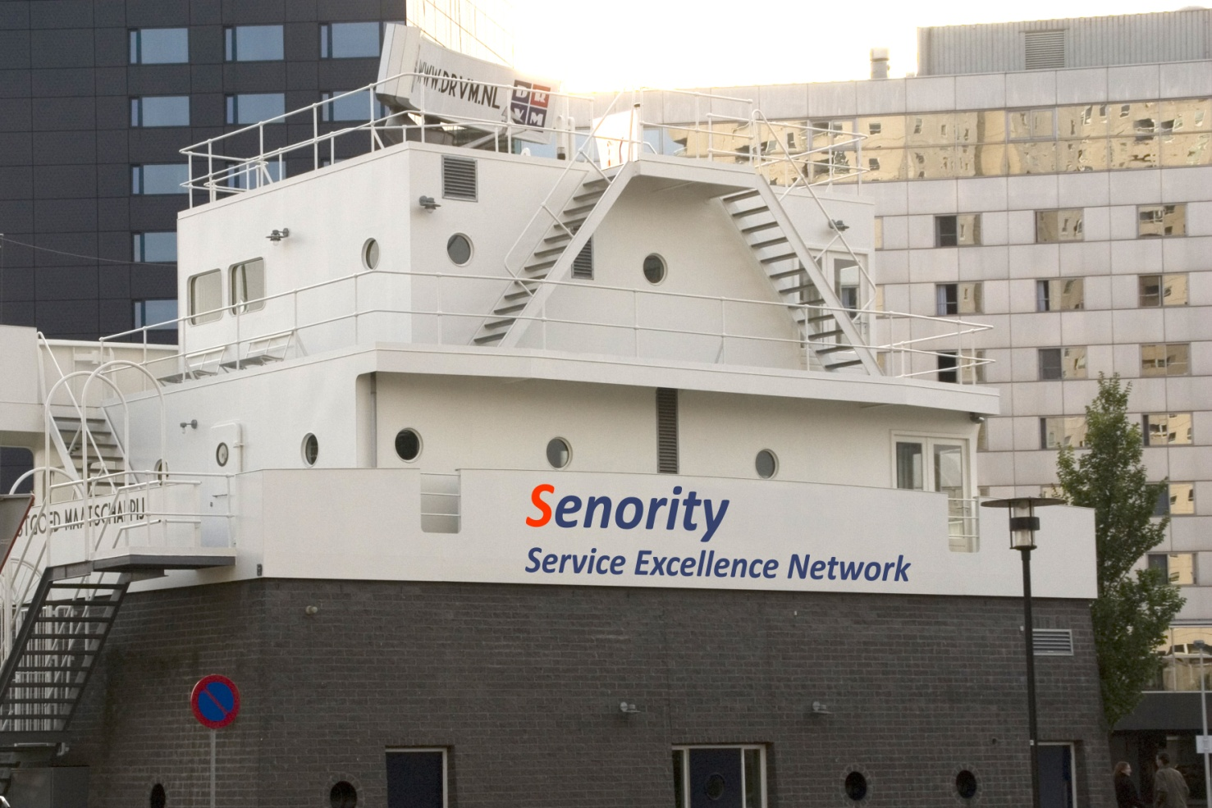
Contact
Rolf van Straaten
Managing Partner - Senority Boompjes 680 3011 XZ Rotterdam
The Netherlands Tel: +31 (0) 10 217 0118 Fax: +31 (0) 10 213 0133 Mobile: +31 (0) 638906446
Rolf.vanStraaten@senority.nl www.Senority.nl
Rob van Leeuwen
Managing Partner - Senority Boompjes 680 3011 XZ Rotterdam
The Netherlands Tel: +31 (0) 10 217 0118 Fax: +31 (0) 10 213 0133 Mobile: +31 (0) 654252085
Rob.vanLeeuwen@senority.nl www.Senority.nl

Slide 10
Appendices

Slide 11
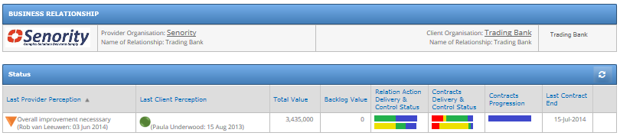
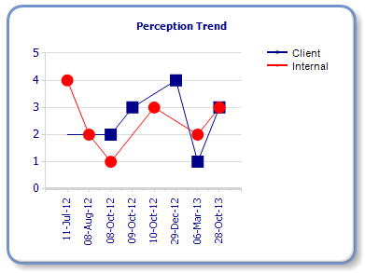
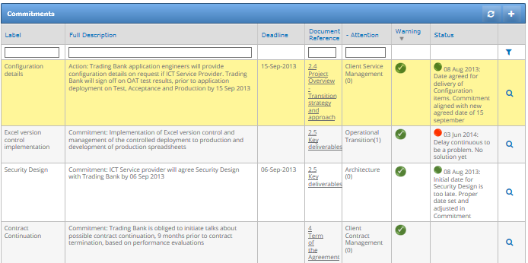
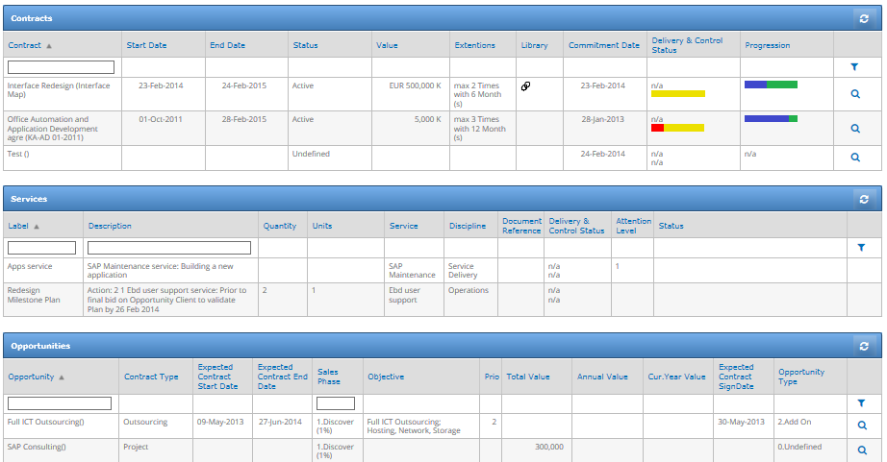
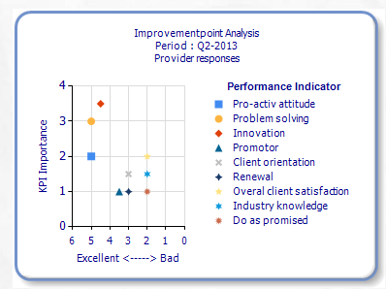
Contract Managers Dashboards
Maximize the return on contracts

Slide 12
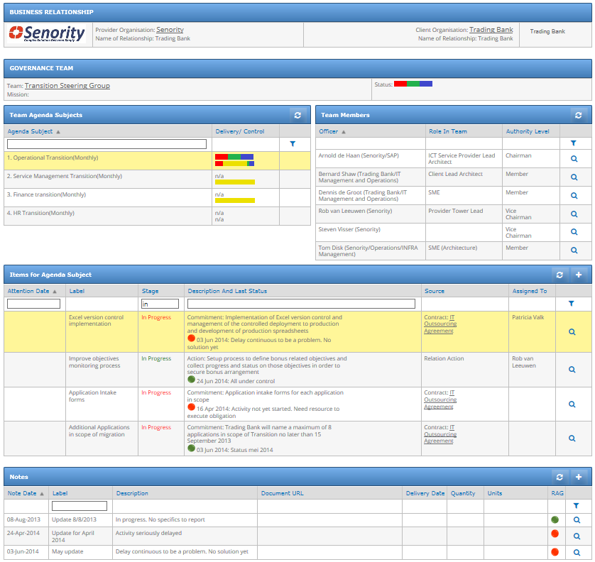
Governance Team Collaboration (Provider & Client)
Evaluetor helps you to install a client driven continuous improvement process with your supplier community.
Bringing insight and visibility on the quality of provided services versus your business needs…….. and the perception thereof.

